Slide 1
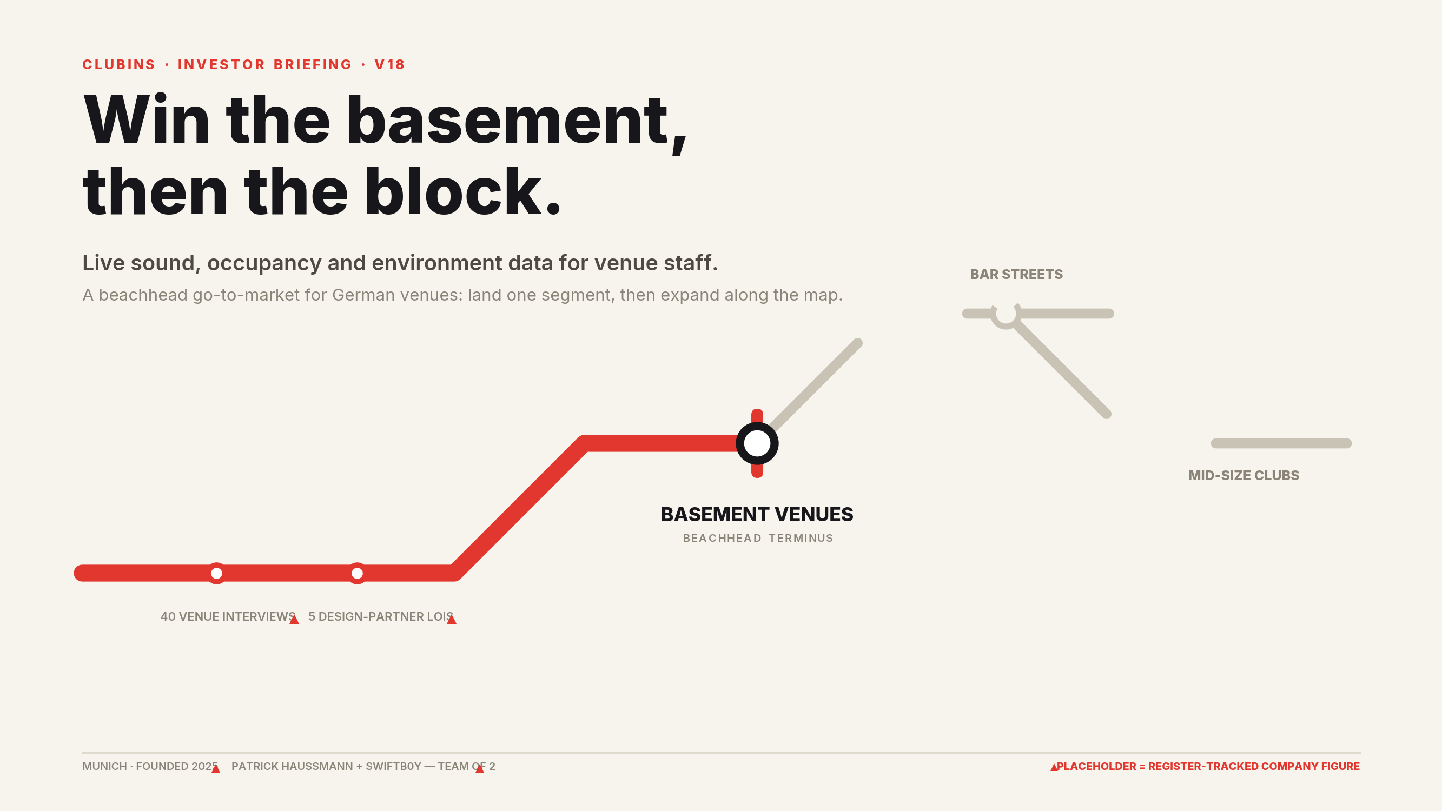
Notes:
Cover. Doctrine: beachhead first, then expansion along the map — the deck is structured as an expansion map. All company figures are PLACEHOLDER values from the Placeholder Metrics Register (wb_cg3xEK66 / sh_vpK5zAbf); market and regulation facts come only from 'Clubins Market & Regulation Facts (sourced)' (art_mYolRwiM).

Slide 2
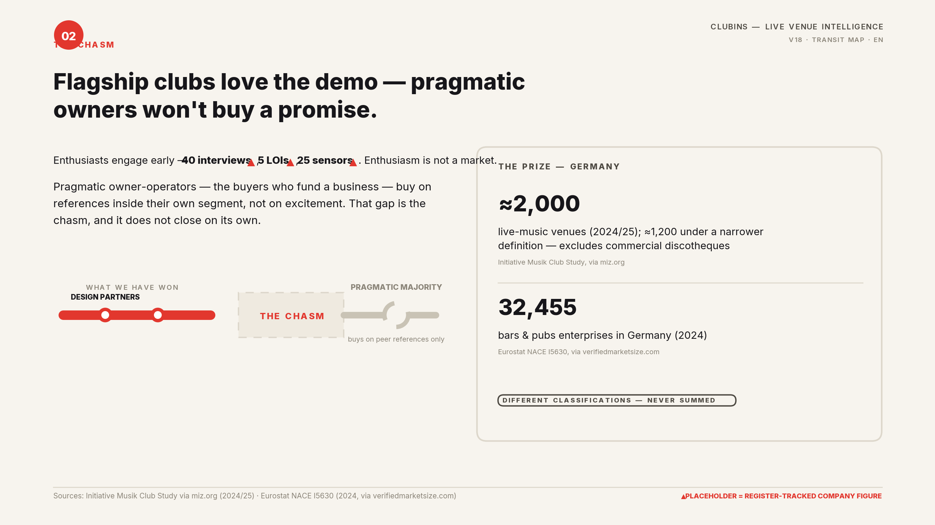
Notes:
Chasm framing: early-adopter enthusiasm (40 interviews, 5 LOIs, 25 sensors — PLACEHOLDER) does not convert into pragmatic purchases without in-segment references. Market context: ≈2,000 German live-music venues (≈1,200 narrower definition; excludes commercial discotheques) — Initiative Musik Club Study via miz.org; 32,455 bars & pubs enterprises (Eurostat NACE I5630, 2024, via verifiedmarketsize.com). Classifications differ — never summed.

Slide 3
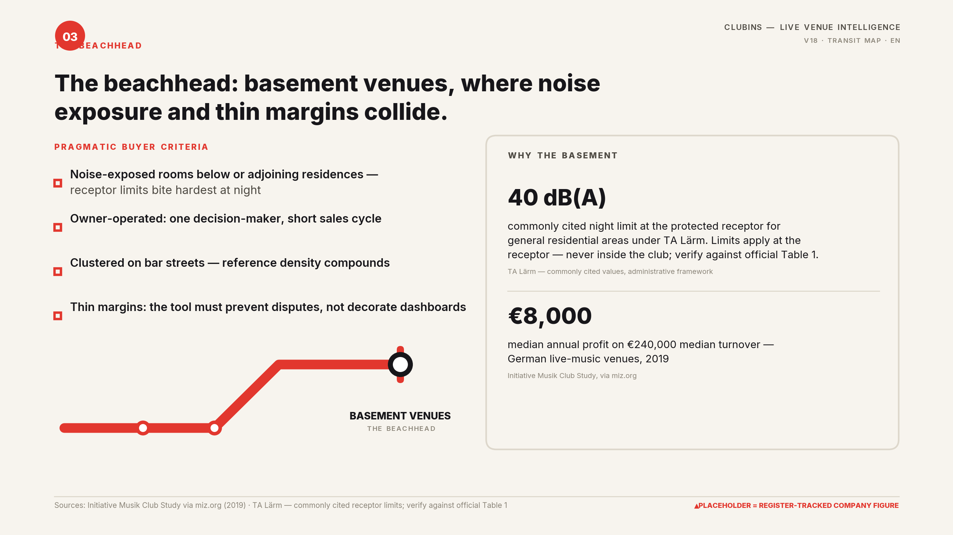
Notes:
Beachhead selection: basement-level small venues. Buyer criteria and economics: 40 dB(A) commonly cited night receptor limit under TA Lärm (limits at the protected receptor, verify against official Table 1); median venue turnover €240,000 / profit €8,000 (2019, Initiative Musik via miz.org).

Slide 4
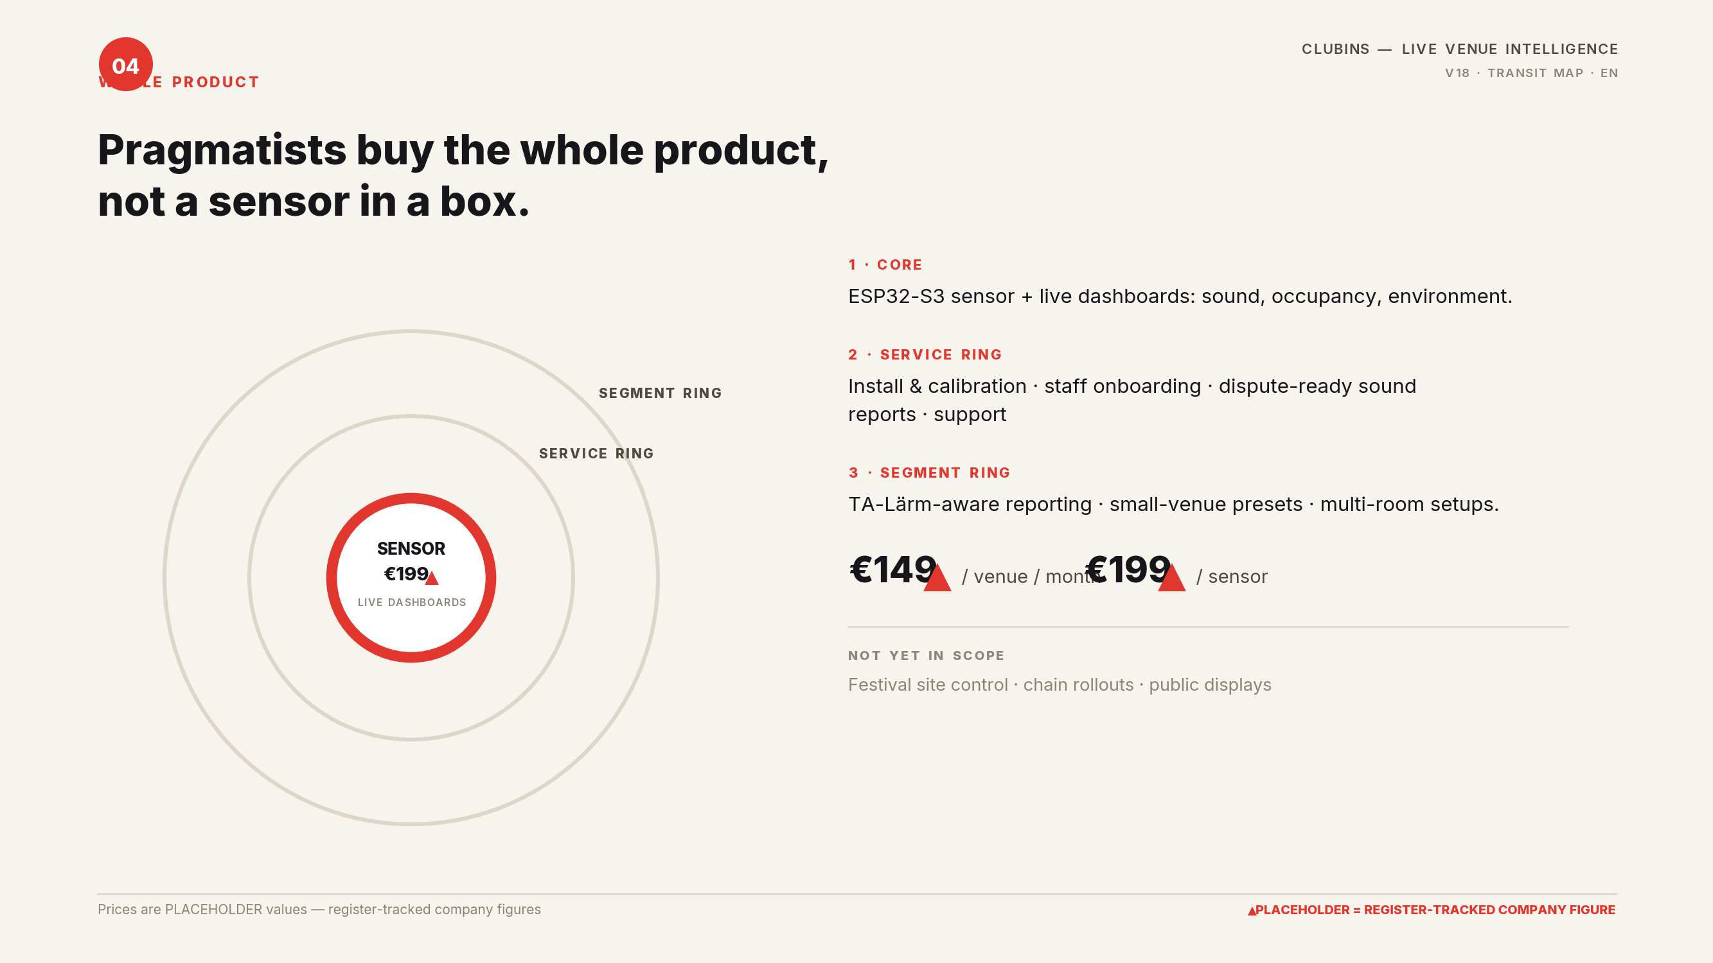
Notes:
Whole product: core sensor + service ring + segment ring. Prices €149/venue/month and €199/sensor are PLACEHOLDER register values. Out-of-scope list enforces segment discipline.

Slide 5
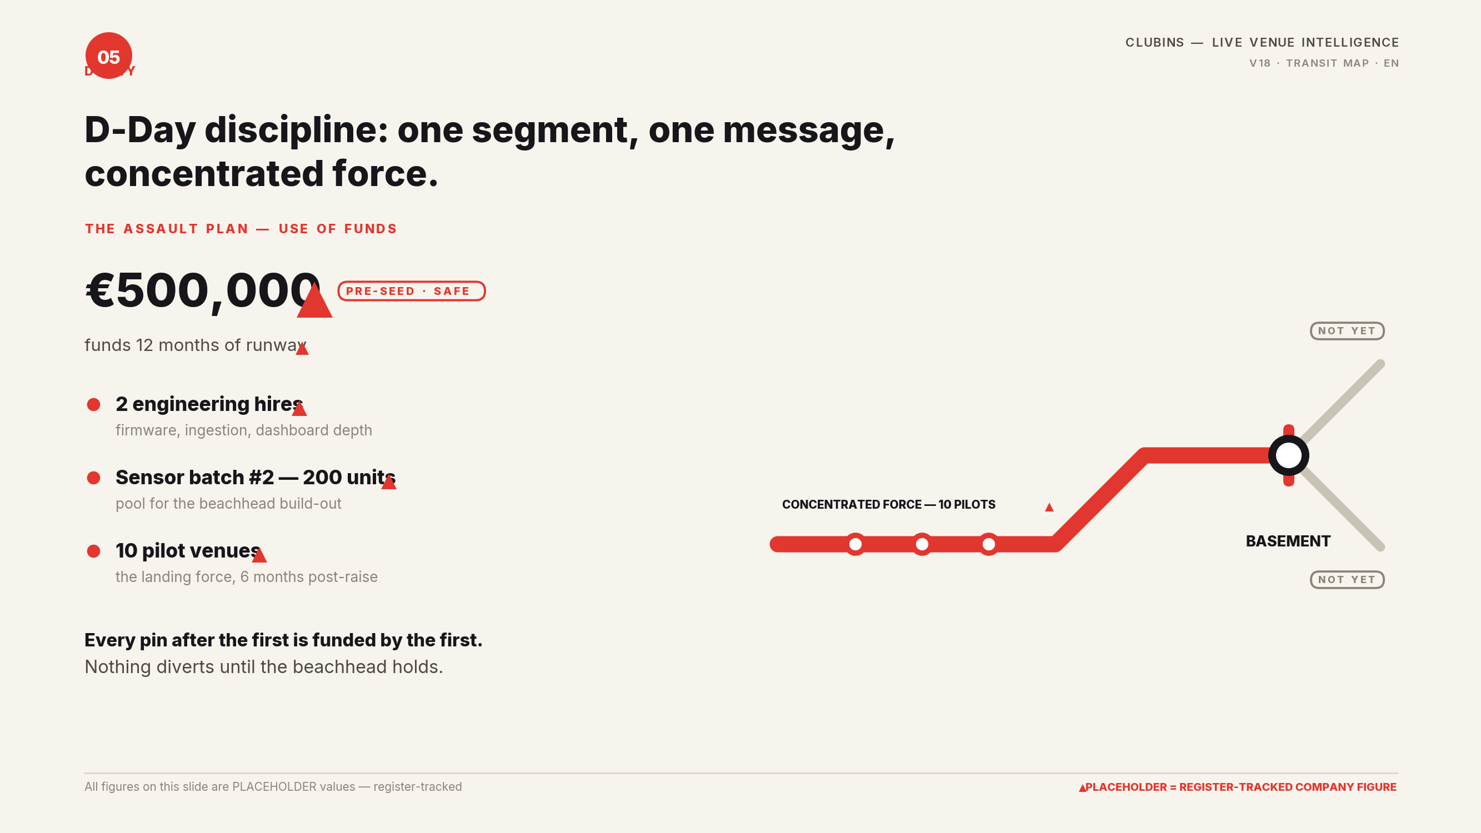
Notes:
D-Day: use of funds — €500k pre-seed SAFE, 12 months runway, 2 engineering hires, sensor batch #2 (200 units), 10 pilot venues. All PLACEHOLDER register values. Nothing diverts until the beachhead holds.

Slide 6
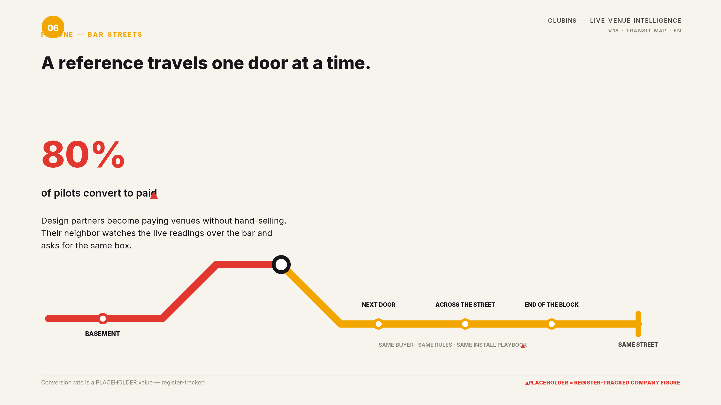
Notes:
Pin one — bar streets: expansion rides on in-segment references; 80% pilot-to-paid conversion is a PLACEHOLDER register value. Same buyer, same rules, same install playbook.

Slide 7
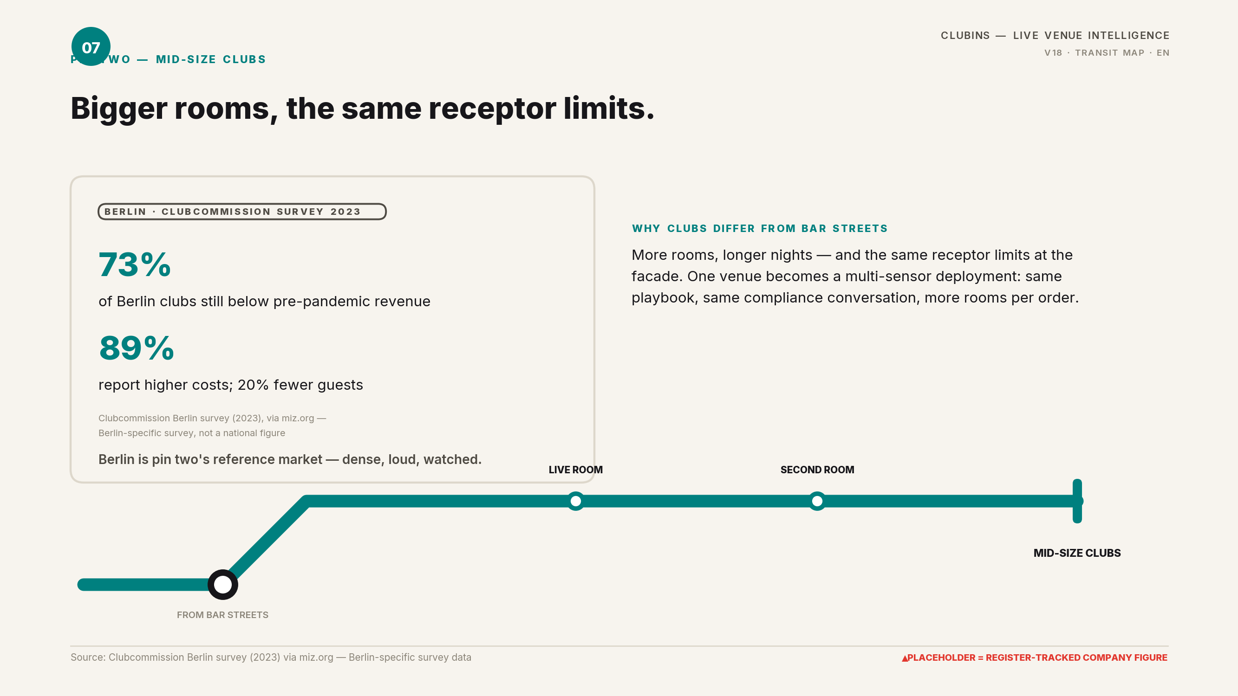
Notes:
Pin two — mid-size clubs: same TA Lärm receptor framework, multi-room deployments. Berlin data: 73% below pre-pandemic revenue, 89% higher costs, 20% fewer guests — Clubcommission Berlin survey (2023) via miz.org; Berlin-specific, not national.

Slide 8
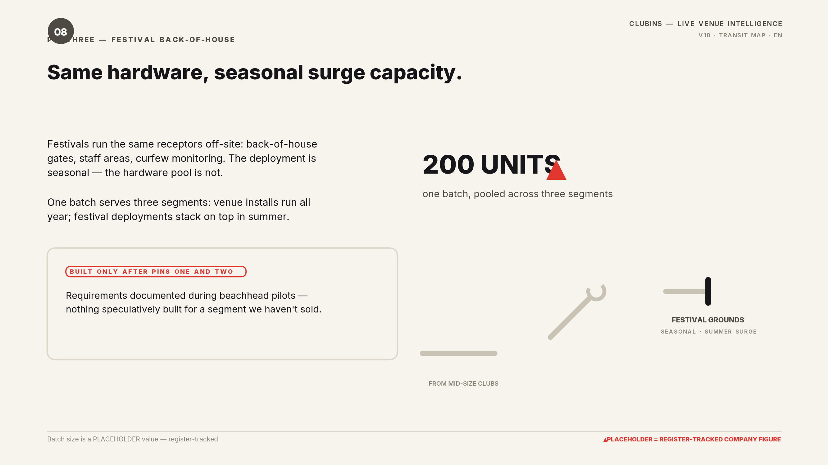
Notes:
Pin three — festival back-of-house: seasonal surge capacity on the same hardware pool (200 units, PLACEHOLDER). Built only after pins one and two compound; requirements documented during beachhead pilots.

Slide 9
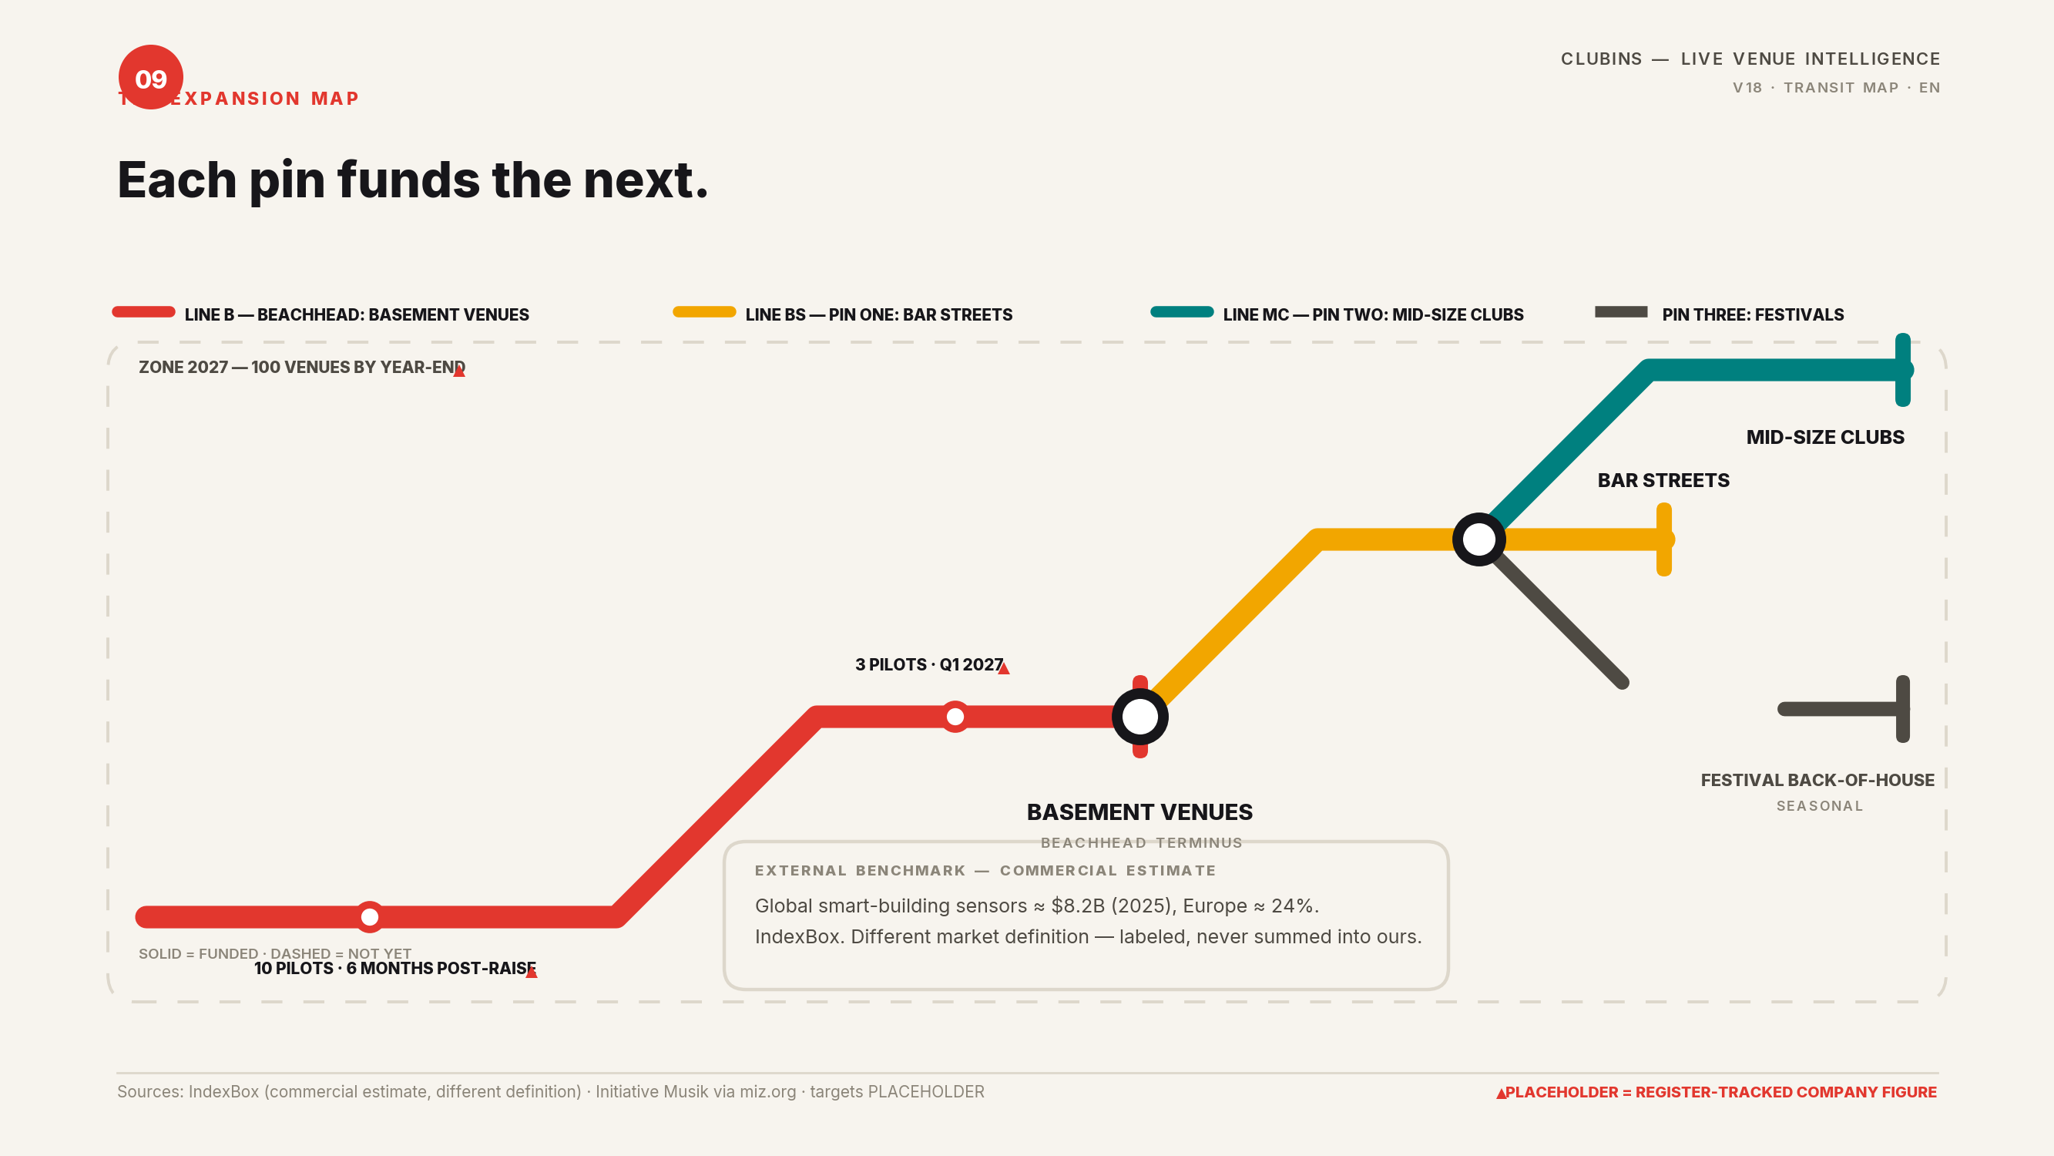
Notes:
The expansion map: red = beachhead line (basement terminus), amber = pin one (bar streets), teal = pin two (mid-size clubs), dashed = pin three (festival, seasonal). Milestones: 10 pilots within 6 months post-raise; 100 venues by end-2027 — PLACEHOLDER register values. External benchmark: global smart-building sensors ≈$8.2B (2025), Europe ≈24% — IndexBox commercial estimate, different market definition, labeled and never summed.

Slide 10

Notes:
Proof stack: 40 interviews, 5 LOIs, 3 pilots (Q1 2027), 120-venue waitlist, 25 sensors — all PLACEHOLDER register values. Segment context: €1.1B turnover, 45,000 employees, ~50M visitors (2019, Initiative Musik via miz.org). Honesty rule: noise framed as documented displacement risk (LiveKomm Red List; Live-DMA/MIZ) — no verified national noise statistic exists, so none is claimed.

Slide 11
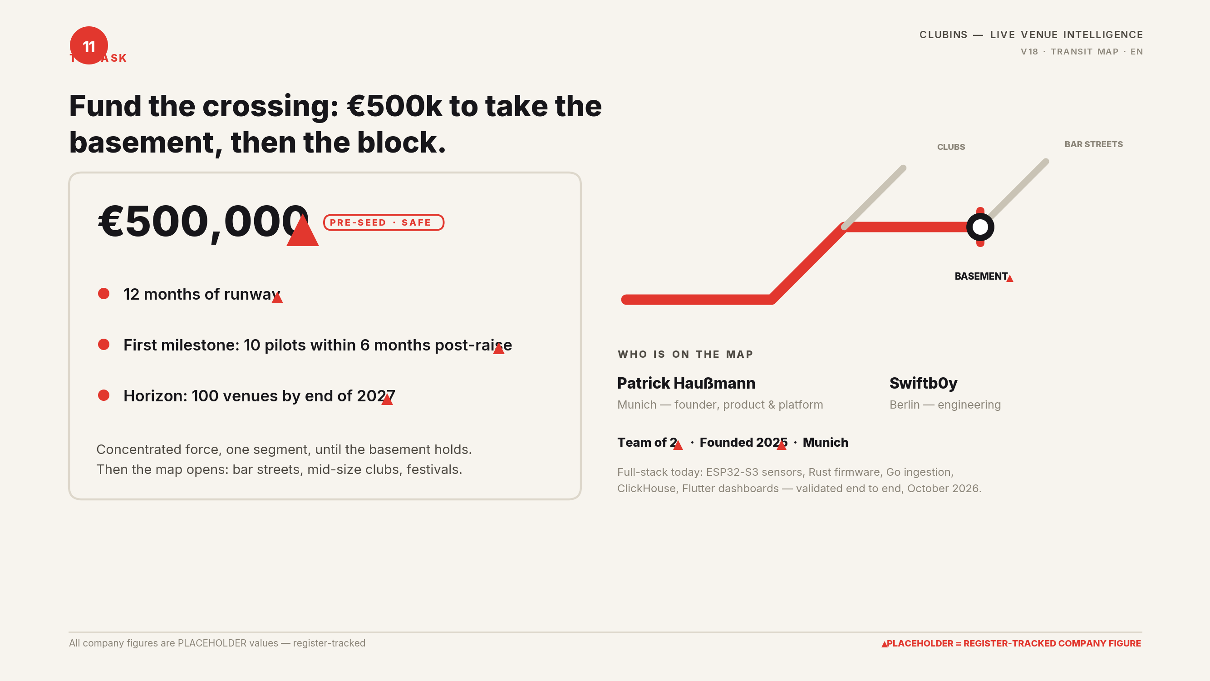
Notes:
THE ASK — and the deck's appendix note. DOCTRINE SOURCE: Geoffrey A. Moore, 'Crossing the Chasm', 3rd edition, HarperBusiness (2014). The beachhead segment selection, whole-product rationale, bowling-pin expansion, and D-Day framing all follow Moore. PRODUCTION NOTE: Clubins Wave Four, deck V18, daylight transit-map wayfinding on off-white paper (signal red / amber / teal routes, station dots, interchange rings, terminus bars). Every invented company number is a PLACEHOLDER value from the Placeholder Metrics Register (workbook wb_cg3xEK66, sheet sh_vpK5zAbf); every market/regulation claim is sourced from 'Clubins Market & Regulation Facts (sourced)' (art_mYolRwiM) and stays qualified. Ask: €500k pre-seed SAFE, 12 months runway — PLACEHOLDER register values.

